Slide 1
Object Oriented Programming—C++ Lecture5 Overloading
Qijun Zhao
College of Computer Science
Sichuan University
Spring 2025

Slide 2
Table of Contents
1. Function Overloading
2. Operator Overloading
3. Class Keywords

Slide 3
Function Overloading

Slide 4
Function Overloading
In C, when we want to write some functions with similar function, only the parameters are different, these functions can not have same name. E.g., function to get absolute value, there are abs(int) and fabs(double) functions(without std:: in C++).
It is quite complicated for programming.
In C++, we can define functions with same name and different parameters. E.g., std::abs() .
struct Complex {
double a, b; // a + bi
};
int add(int a, int b) {
return a + b;
}
Complex add(Complex a, Complex b) {
return {a.a + b.a, a.b + b.b};
}

Slide 5
Function Overloading
Differences between functions with same name must include parameters (type and/or number of parameters).
void func(int a); // ok
void func(double a); // ok
int func(int a); // compile error

Slide 6
Extern keyword*
For there exists function overloading in C++, the function will be decorated with the type of parameters between compilation.
It is different from C, so we can’t directly use C++ functions in C.
Use extern keyword can let C++ functions be used in C.
// a.cpp
extern "C" {
int add(int a, int b) {
return a + b;
}
}
// main.c
#include <stdio.h>
int add(int, int);
int main() {
printf("%d\n", add(3, 4));
return 0;
}
Use command gcc main.c a.cpp –o main to compile the files.

Slide 7
Operator Overloading

Slide 8
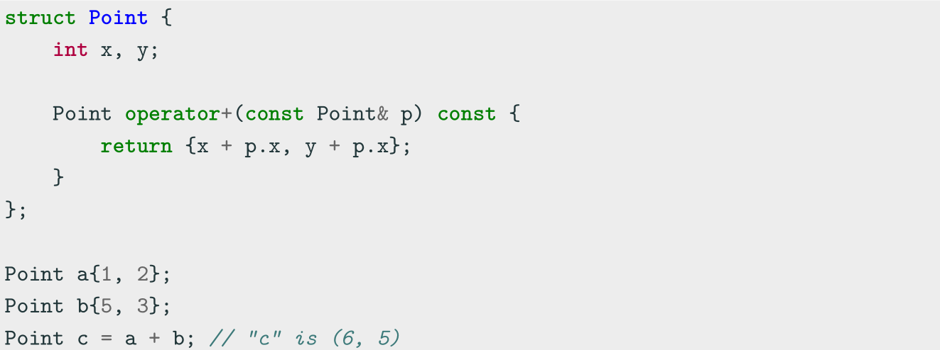
Operator Overloading
Operator Overloading
Operator overloading is a special case of polymorphism in which some operators are treated as polymorphic functions and have different behaviors depending on the type of its arguments. Operator can be seen as a special function, so operator overloading also can be seen as special function overloading.

Slide 9
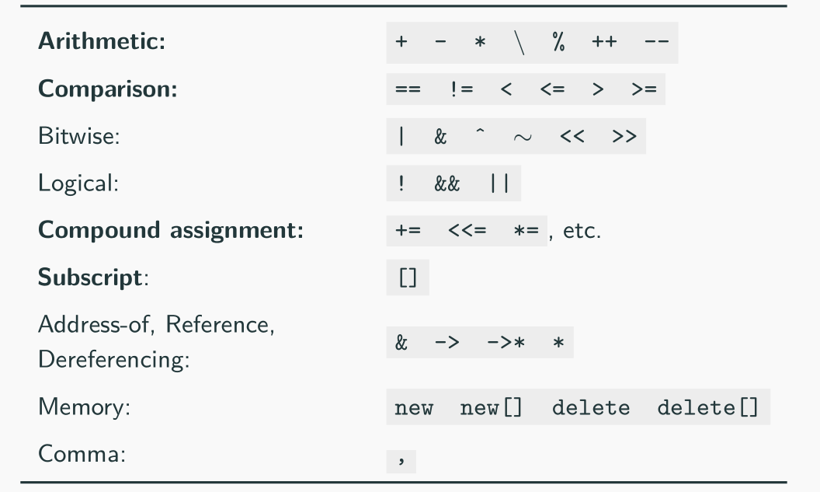
Operator Overloading
Categories not in bold are rarely used in practice
Operators which cannot be overloaded: ? . .* :: sizeof typeof

Slide 10
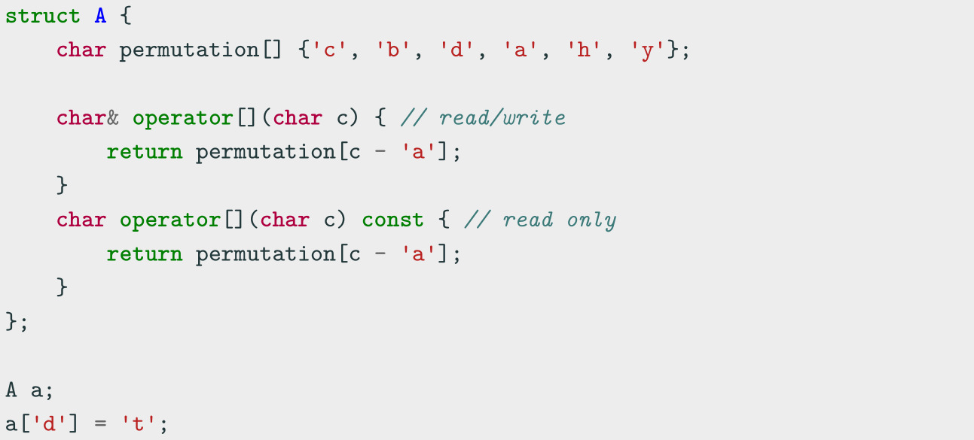
Subscript Operator operator[]
The array subscript operator[] allows accessing to an object in an array-like fashion
The operator accepts everything as parameter, not just integers

Slide 11
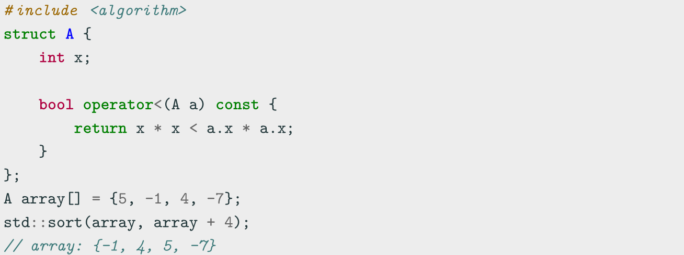
Comparison Operator operator<
Relational and comparison operators operator<, <=, ==, >= > are used for
comparing two objects
In particular, the operator< is used to determine the ordering of a set of objects
(e.g. sort)

Slide 12
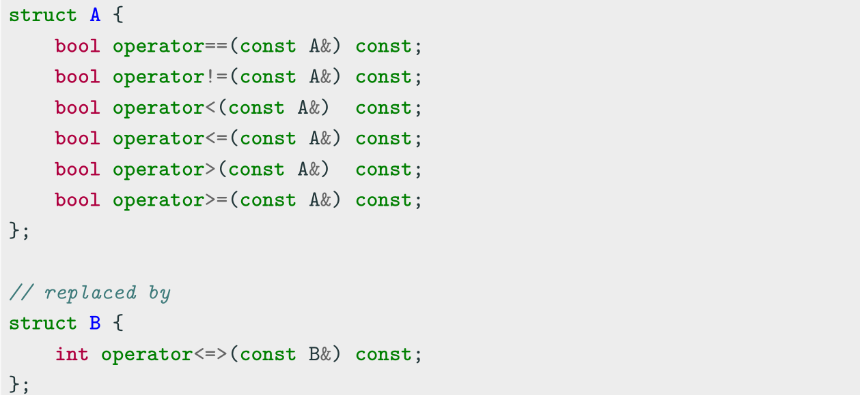
Spaceship Operator operator<=>
C++20 allows overloading the spaceship operator <=> for replacing all comparison
operators operator<, <=, ==, >= >

Slide 13
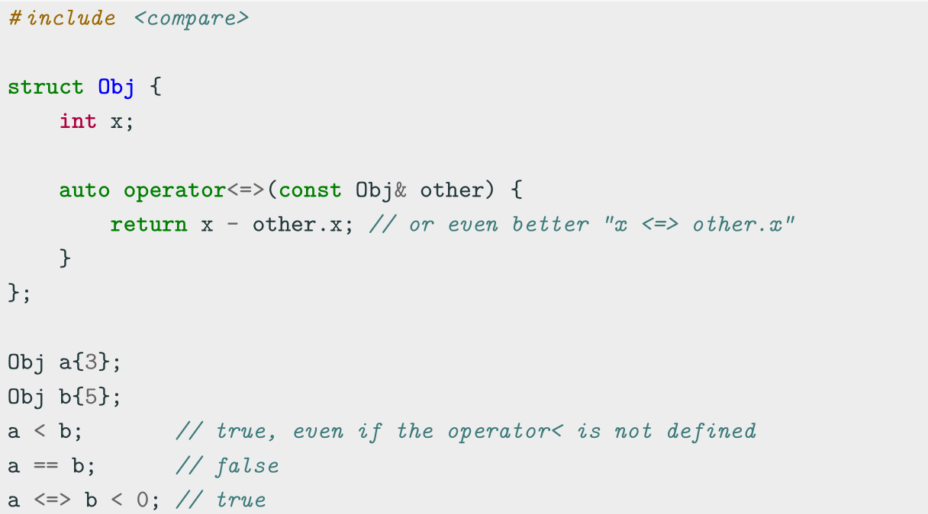
Spaceship Operator operator<=>

Slide 14
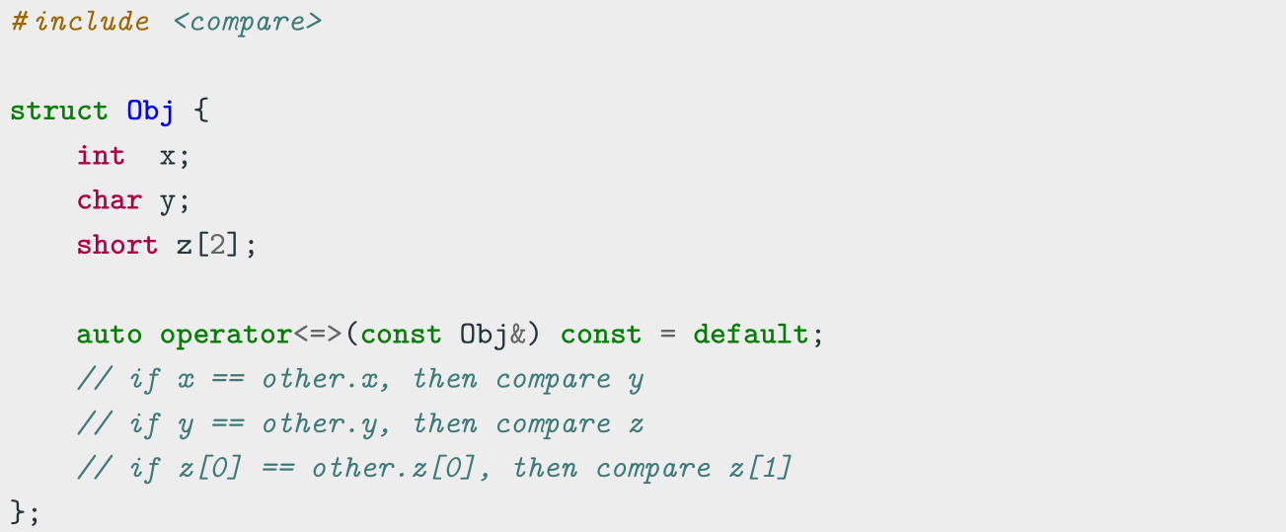
Spaceship Operator operator<=>
The compiler can also generates the code for the spaceship operator = default , even
for multiple fields and arrays, by using the default comparison semantic of its members

Slide 15
Spaceship Operator operator<=>
The spaceship operator can use one of the following ordering:
strong ordering • if a is equivalent to b , f(a) is also equivalent to f(b)
• exactly one of < , == , or > must be true
○ integral types, e.g. int , char
weak ordering • if a is equivalent to b , f(a) may not be equivalent to f(b)
• exactly one of < , == , or > must be true
○ rectangles, e.g. R{2, 5} == R{5, 2}
partial ordering • if a is equivalent to b , f(a) may not be equivalent to f(b)
• < , == , or > may all be false
○ floating-point float , e.g. NaN

Slide 16
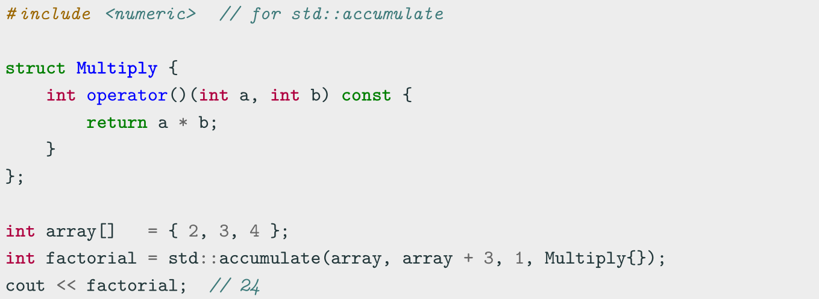
Function Call Operator operator()
The function call operator operator() is generally overloaded to create objects
which behave like functions, or for classes that have a primary operation (see Basic
Concepts IV lecture)

Slide 17
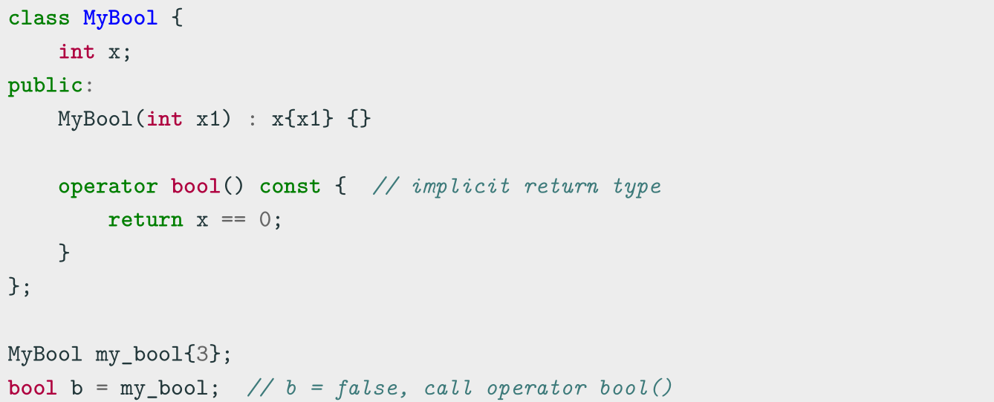
Conversion Operator operator T()
The conversion operator operator T() allows objects to be either implicitly or
explicitly (casting) converted to another type

Slide 18
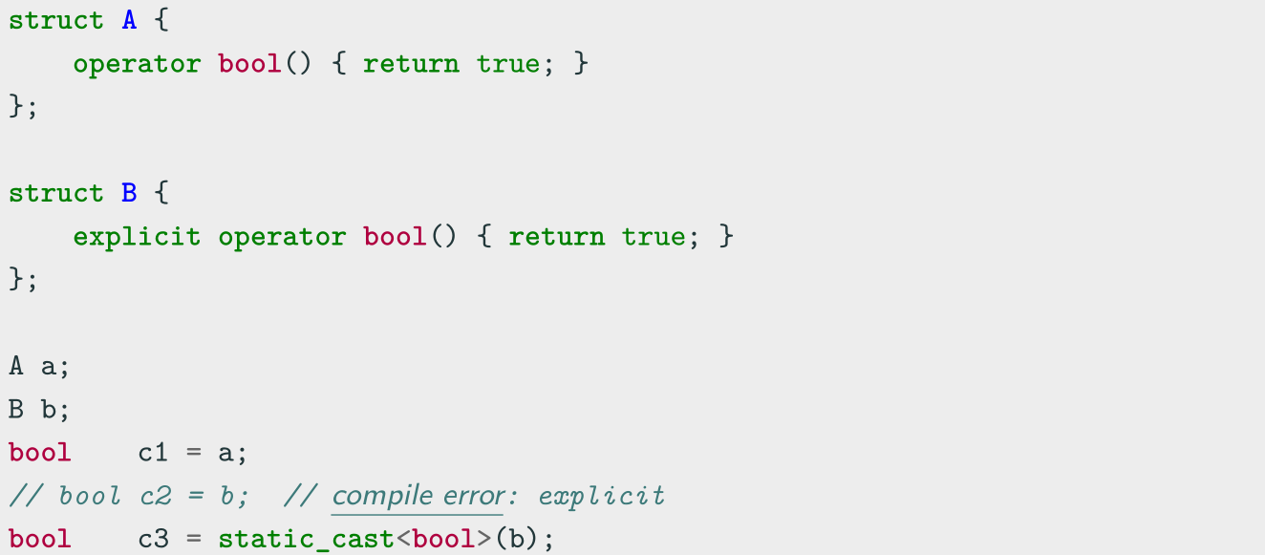
Conversion Operator operator T()
C++11 Conversion operators can be marked explicit to prevent implicit
conversions. It is a good practice as for class constructors

Slide 19
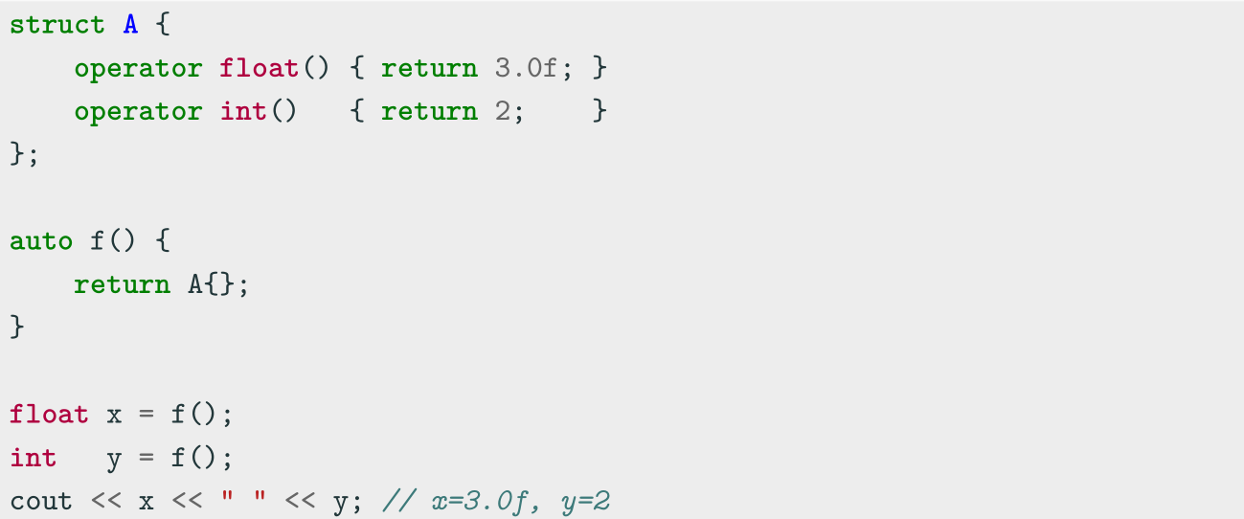
Return Type Overloading Resolution

Slide 20
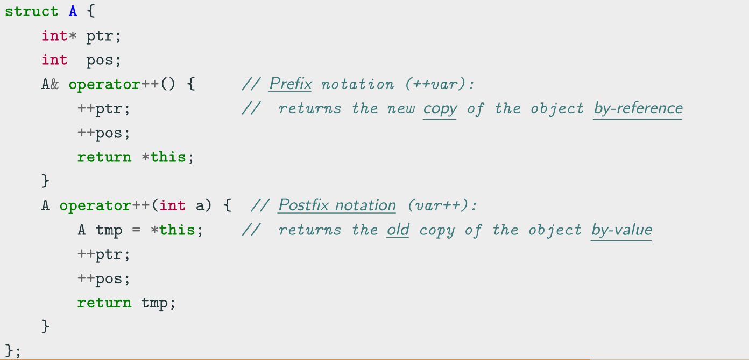
Increment and Decrement Operators operator++/--
The increment and decrement operators operator++, operator-- are used to update
the value of a variable by one unit

Slide 21
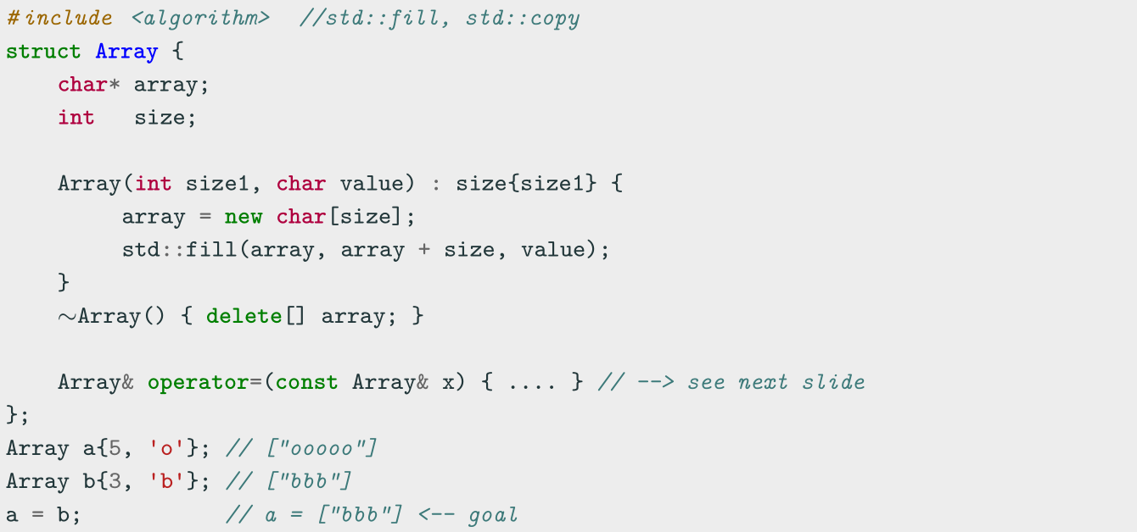
Assignment Operator operator=
The assignment operator operator= is used to copy values from one object to
another already existing object

Slide 22
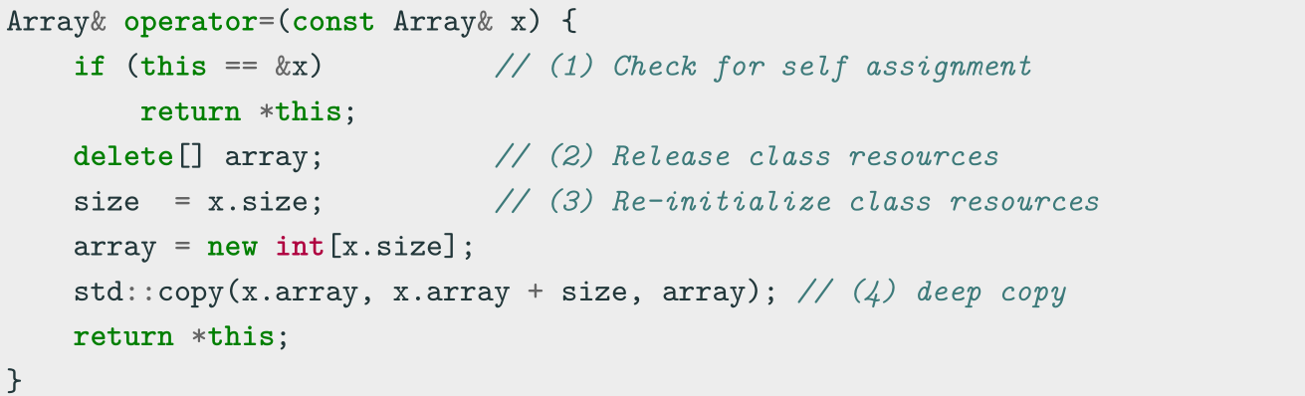
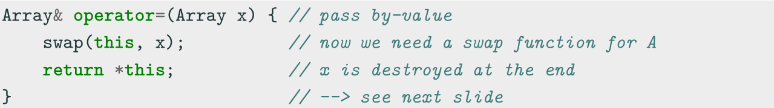
Assignment Operator operator=
First option:
Second option (less intuitive):

Slide 23
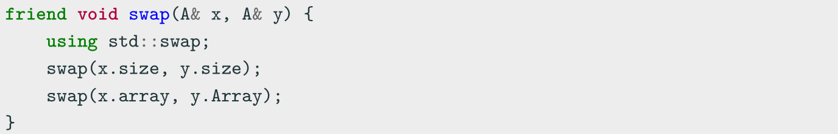
Assignment Operator operator=
swap method:
• why using std::swap ? if swap(x, y) finds a better match, it will use that instead of std::swap
• why friend ? it allows the function to be used from outside the structure/class scope

Slide 24
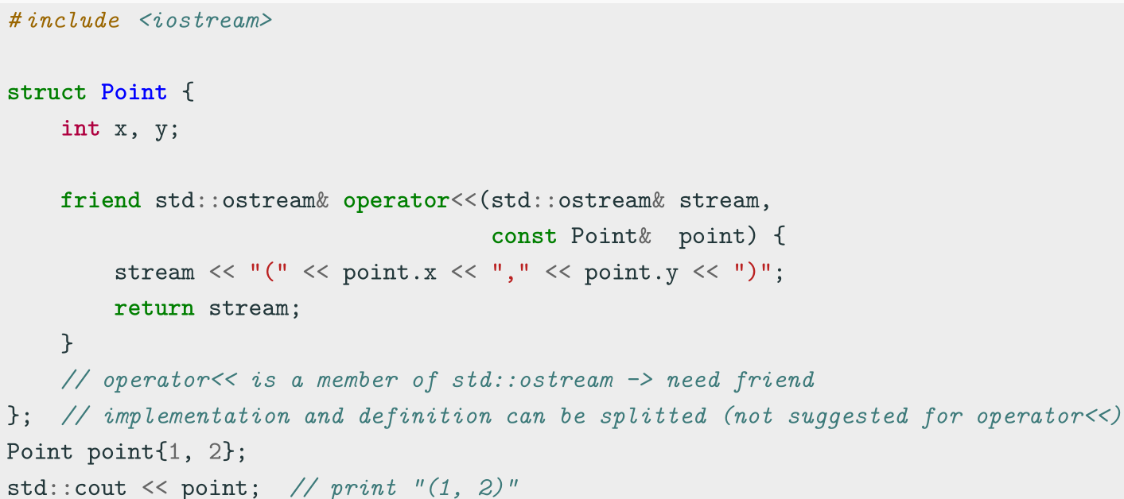
Stream Operator operator<<
The stream operation operator<< can be overloaded to perform input and output
for user-defined types

Slide 25
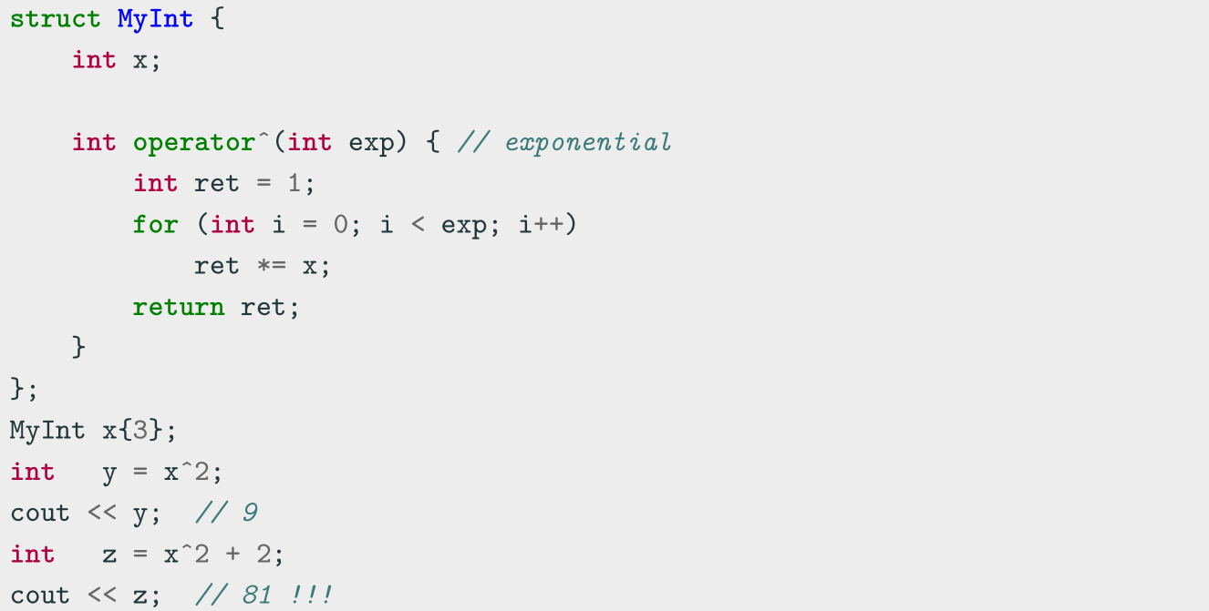
Operators Precedence

Slide 26
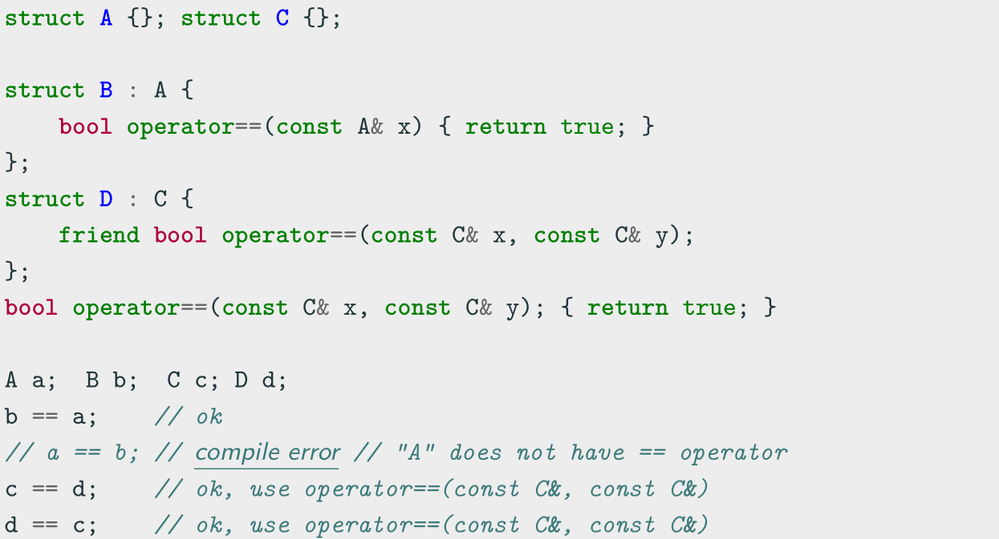
Binary Operators Note
Binary operators should be implemented as friend methods

Slide 27
Class Keywords

Slide 28
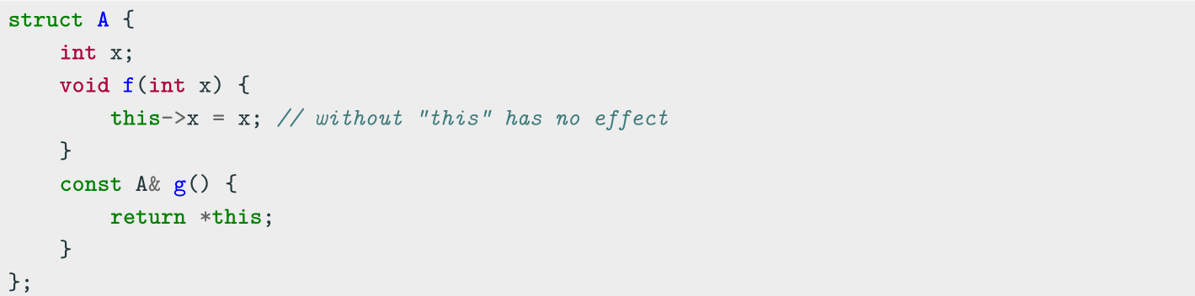
Class Keywords——this
this
Every object has access to its own address through the const pointer this
Explicit usage is not mandatory (and not suggested)
this is necessary when:
• The name of a local variable is equal to some member name
• Return reference to the calling object

Slide 29
Class Keywords——static
static
The keyword static declares members (fields or methods) that are not bound to class instances. A static member is shared by all objects of the class
• A static member function can only access static class members
• A non- static member function can access static class members
• Non-const static data members cannot be directly initialized inline (see
Translation Units lecture)...before C++17

Slide 30
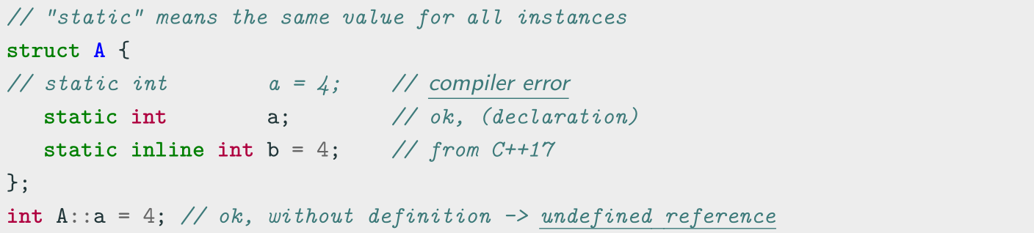
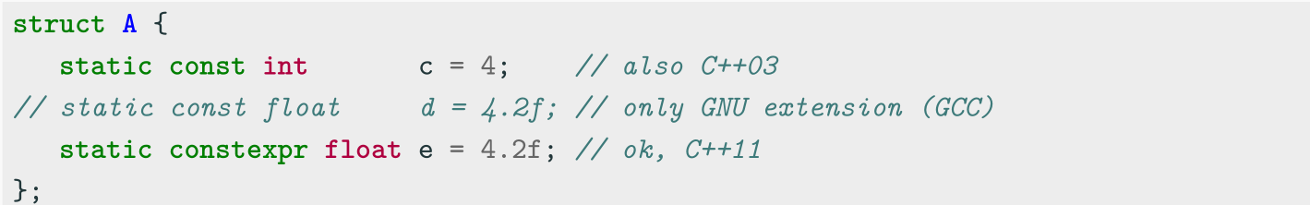
Class Keywords——static-Initialization
Mutable static members
Constant static members

Slide 31
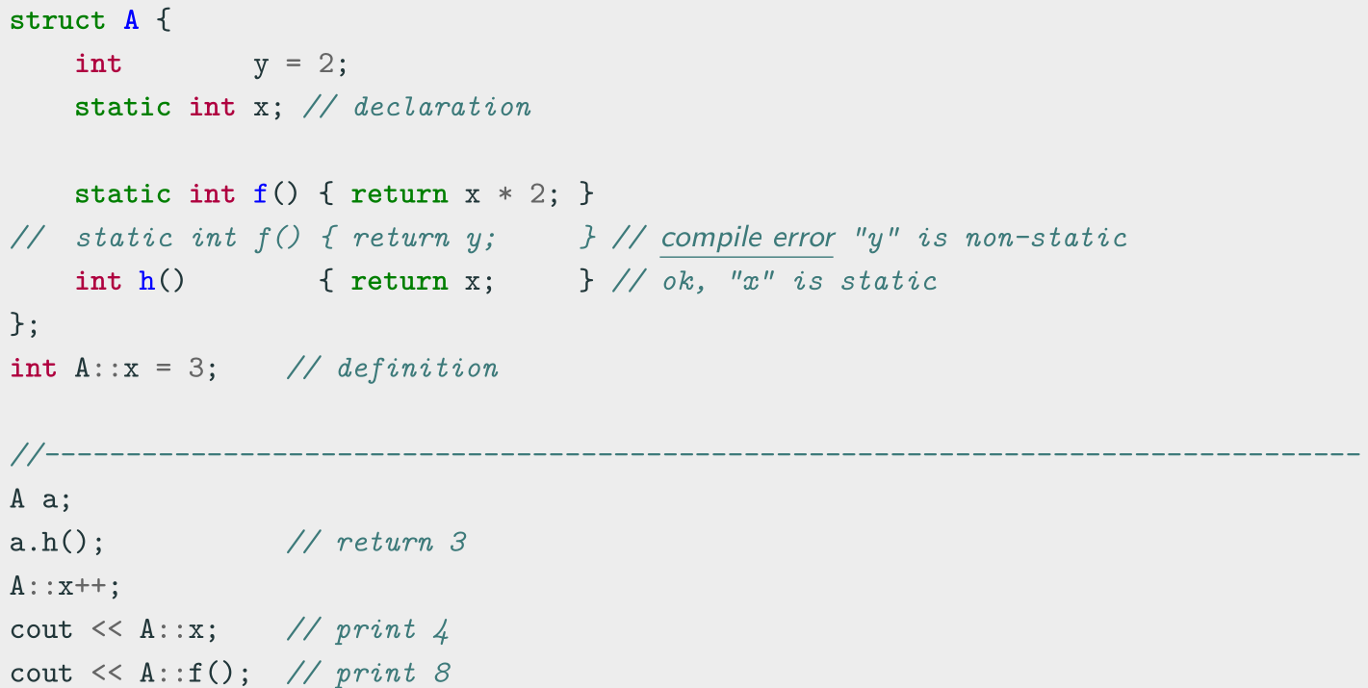
Class Keywords——static-Example

Slide 32
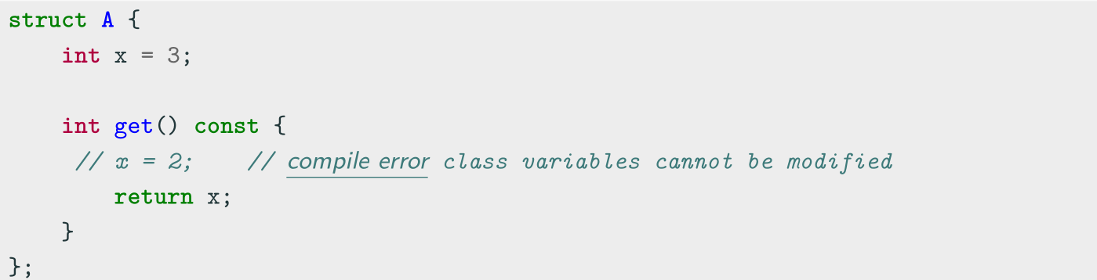
Class Keywords——const
Const member functions
Const member functions (inspectors or observer) are functions marked with const that are not allowed to change the object state
Member functions without a const suffix are called non-const member functions or mutators. The compiler prevents from inadvertently mutating/changing the data members of observer functions

Slide 33
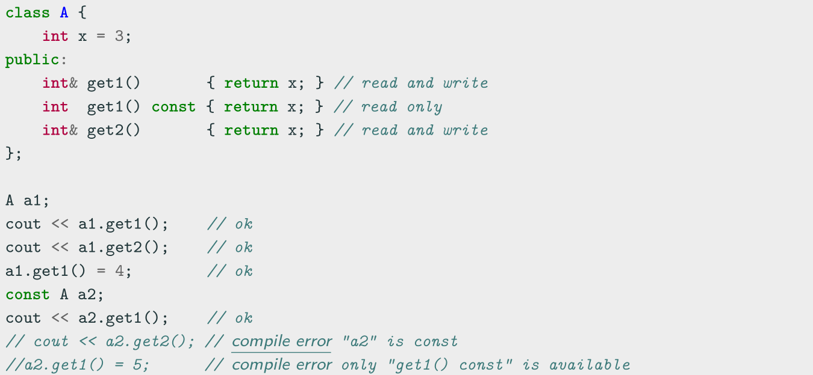
Class Keywords——const Overloading
The const keyword is part of the functions signature. Therefore a class can
implement two similar methods, one which is called when the object is const , and
one that is not

Slide 34
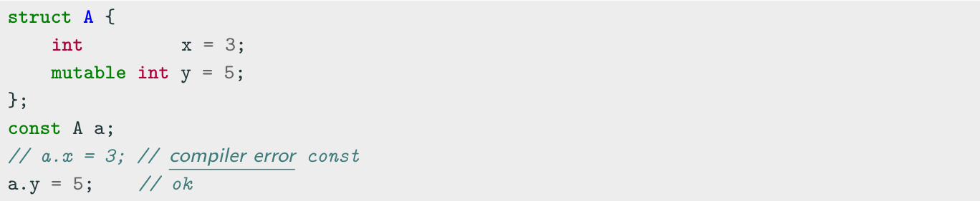
Class Keywords——mutable
mutable
mutable members of const class instances are modifiable
Constant references or pointers to objects cannot modify objects in any way, except for
data members marked mutable
• It is particularly useful if most of the members should be constant but a few need to be
modified
• Conceptually, mutable members should not change anything that can be retrieved from
the class interface

Slide 35
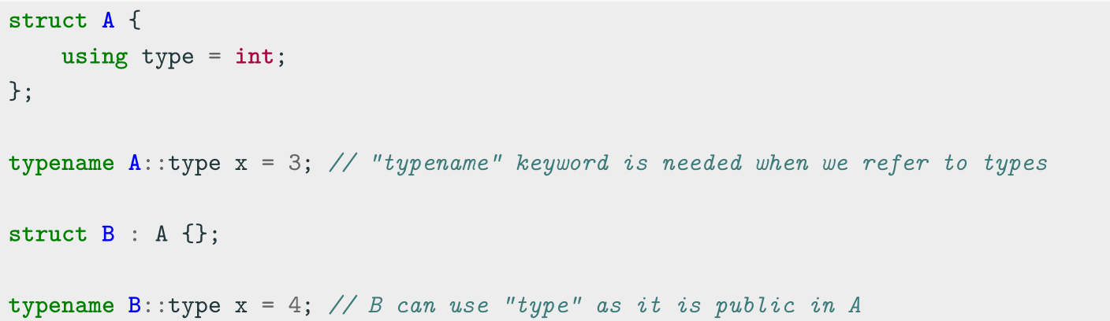
Class Keywords——using for type declaration
The using keyword is used to declare a type alias tied to a specific class

Slide 36
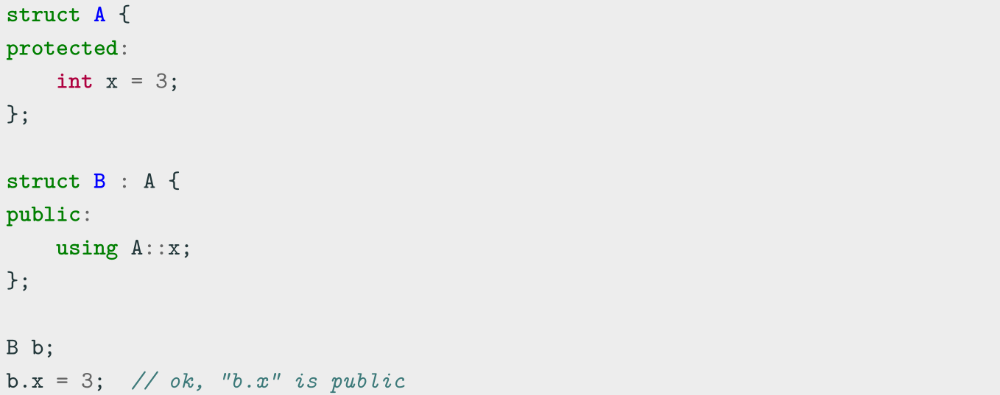
Class Keywords——using for Inheritance
The using keyword can be also used to change the inheritance attribute of member
data or functions

Slide 37
Class Keywords——friend
friend Class
A friend class can access the private and protected members of the class in which it is declared as a friend
Friendship properties:
• Not Symmetric: if class A is a friend of class B, class B is not automatically a
friend of class A
• Not Transitive: if class A is a friend of class B, and class B is a friend of class C,
class A is not automatically a friend of class C
• Not Inherited: if class Base is a friend of class X, subclass Derived is not
automatically a friend of class X; and if class X is a friend of class Base, class X is
not automatically a friend of subclass Derived

Slide 38
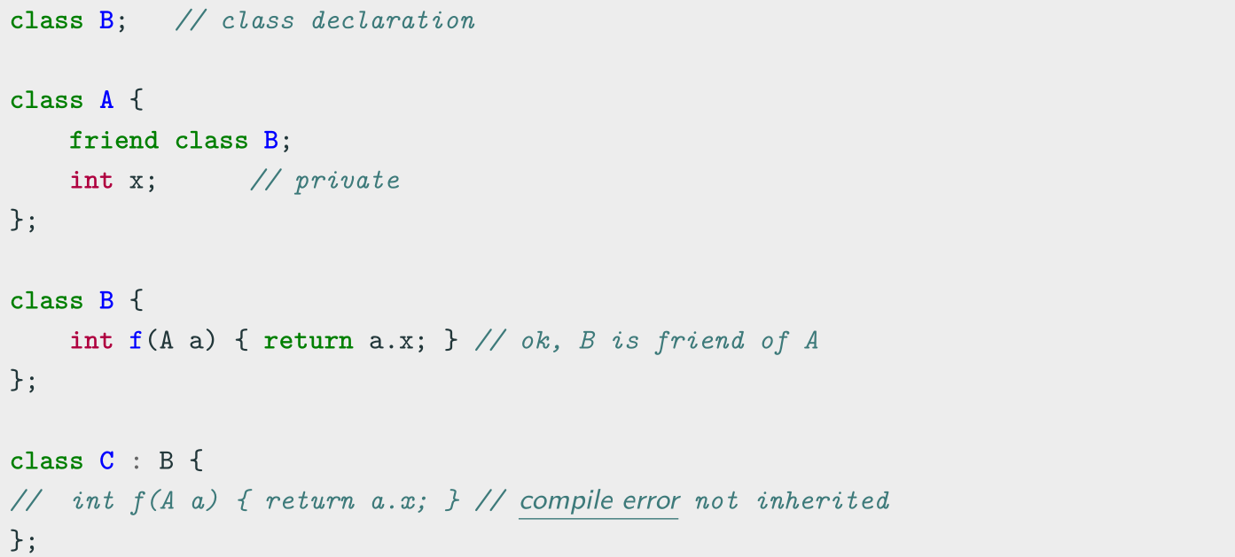
Class Keywords——friend

Slide 39
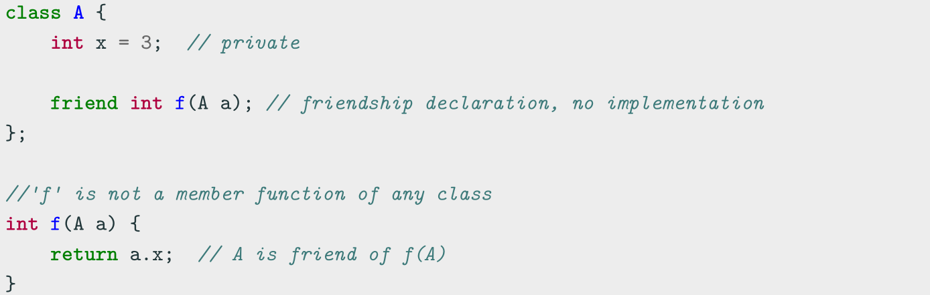
Class Keywords——friend
friend Method
A non-member function can access the private and protected members of a class if it is declared a friend of that class
friend methods are commonly used for implementing the stream operator operator<<

Slide 40
Class Keywords——default
default Keyword ( C++11 )
The default keyword explicitly marks a special constructor as default. It has better readability compared with an empty body.
class A {
public:
A() = default; // make the default constructor default. Same as "A(){}"
A(const A&) = default; // make the copy constructor default.
};

Slide 41
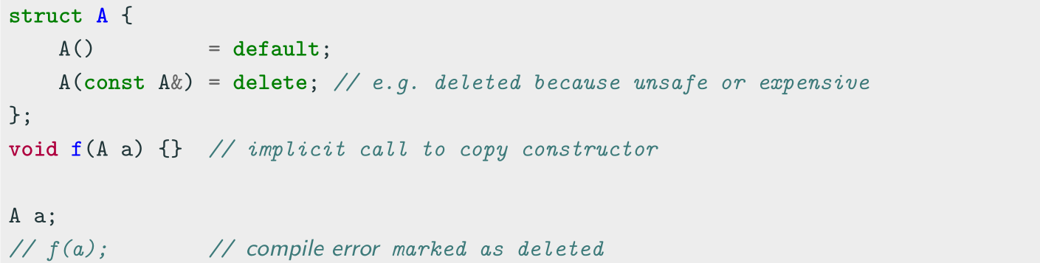
Class Keywords——delete
delete Keyword ( C++11 )
The delete keyword explicitly marks a member function as deleted and any use results in a compiler error. When it is applied to copy/move constructor or assignment, it prevents the compiler from implicitly generating these functions
The default copy/move functions for a class can produce unexpected results. The keyword delete prevents these errors

Slide 42
Coding to make the world better
Qijun Zhao
qjzhao@scu.edu.cn

